Slide 1
Forestry Scenario Planner
COST MODEL

Slide 2
How much?
Net revenue = Timber revenue − Delivered costs

Slide 3
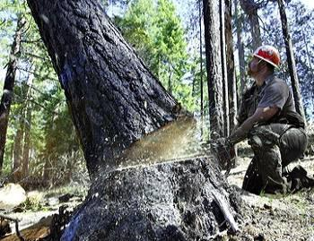
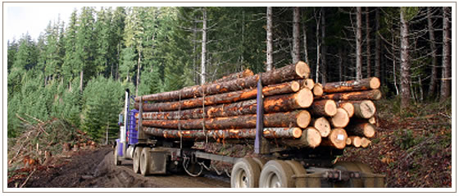
What are the Delivered Costs?
Harvest Costs
Hauling Costs

Slide 4


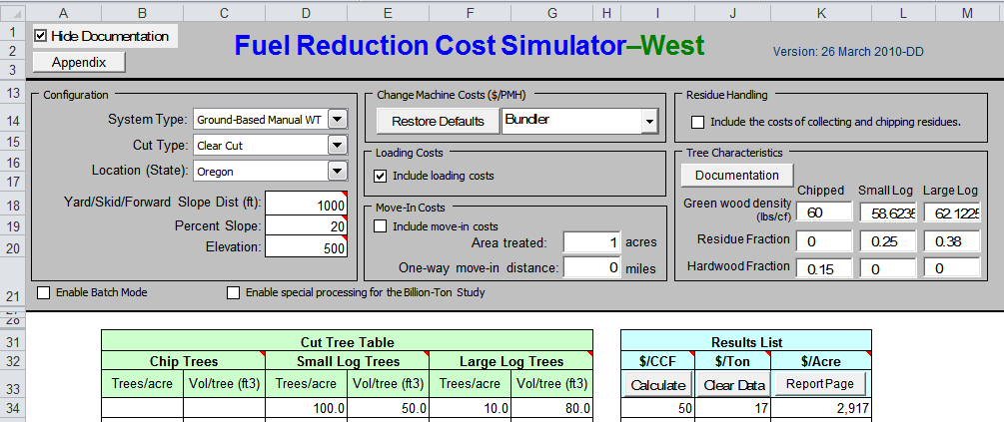
Harvest Model

Slide 5
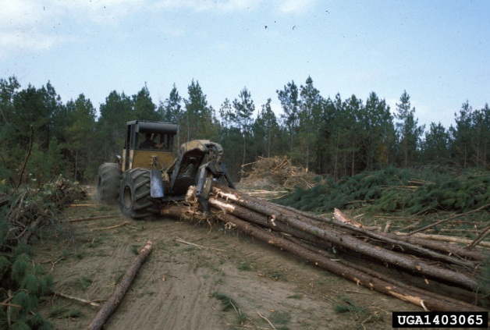
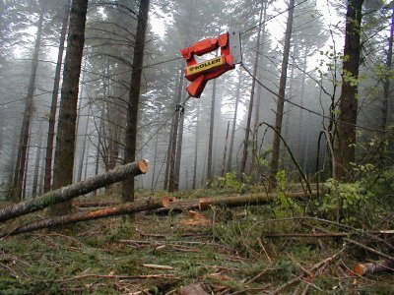
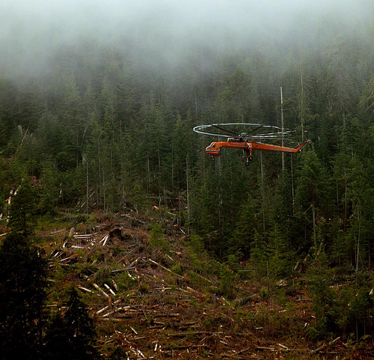
Harvest Model
Ground-Based
Cable
Helicopter
Slope < 40 %
Manual/ Mechanized
Skid Dist < 1300 ft
Manual
No limitation
Manual

Slide 6

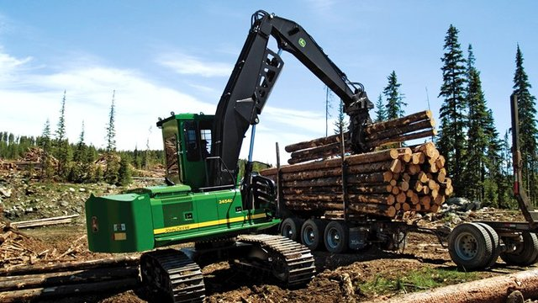
How does it work?
Felling
Skidding
Loading
How long does it take?
How much does it cost per hour?
$/ft³

Slide 7





Input Data
Slope
Skid Dist
Tree Data
centroid stand
stand landing
road landing

Slide 8
What are the Delivered Costs?
Harvest Costs
Hauling Costs
= $/ft³ x total ft³

Slide 9
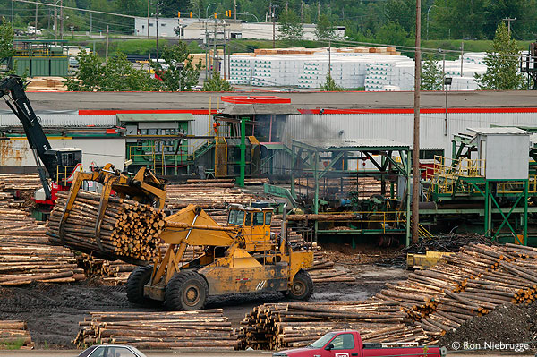
How does it work?
Total Haul Cost = $/min x total min x trips

Slide 10
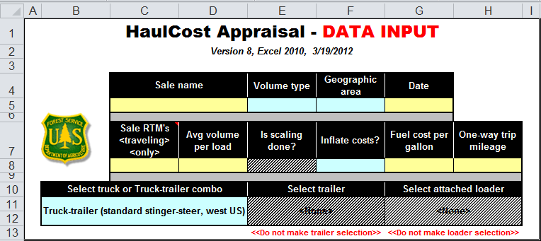
Hauling Model

Slide 11
Hauling Model
Ownership Cost
+ Labor Cost
+ Operating Cost
Haul Cost $/min
Total Haul Cost = $/min x total min x trips

Slide 12







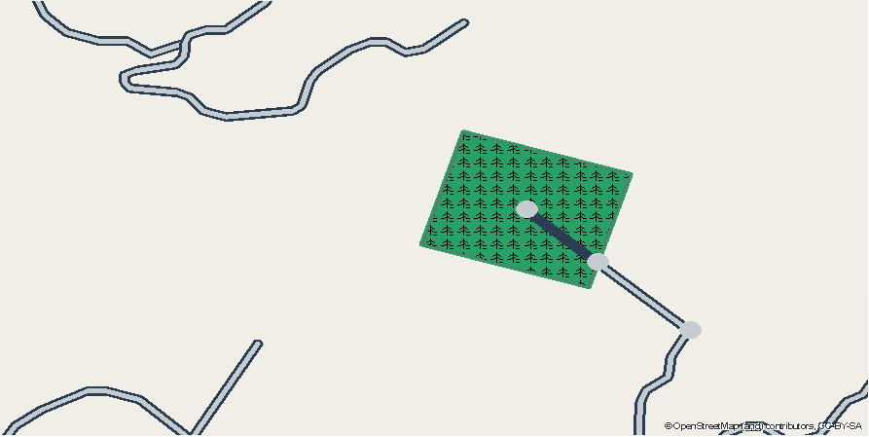

Hauling Model

Slide 13
What are the Delivered Costs?
Harvest Costs
Trucking Costs
= $/ft³ x total ft³
= $/min x total min x trips

Slide 14
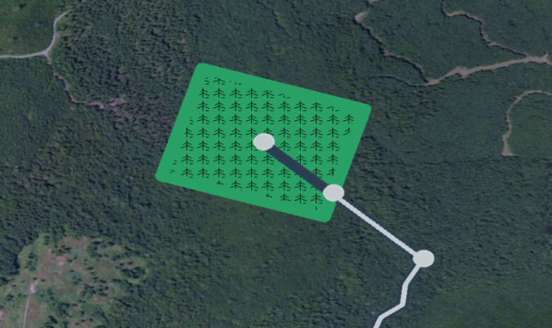
What are the Delivered Costs?
Slope: 21.75 %
Area: 66.37 ac
Skid Distance: 1000 ft
Haul distance (one-way): 8.94 miles
Haul distance extension: 0.27 miles
Haul time (one-way): 32.92 min
Total Volume: 464,596 ft³
Haul trips: 547
Chip Trees
Removals: -
Volume: -
Small Log Trees
Removals: 100 T/ac
Volume: 70 ft³
Large Log Trees
Removals: -
Volume: -
Haul Cost: 0.60 $/min
Total Haul Cost: 21,753 $
Harvest System: GroundBasedMechWT
Harvest Cost: 0.41 $/ft³
Total Harvest Cost: 192,018 $
Total Cost: 213,771 $

Slide 15

What’s behind it?
GDAL/OGR
numpy, xlrd
OSRM Routing API
requests and json

Slide 16
What’s left?
Improve routing/ skidding distance
Create road model
Update machine costs
Testing
Statistical analysis of harvest model

Slide 17
Forestry Scenario Planner
COST MODEL
github.com/ustroetz
ustroetz@gmail.com

Slide 18
centroid stand
stand landing
road landing
skidding distance
haul distance extension

